Slide 1
NLH Update

Slide 2
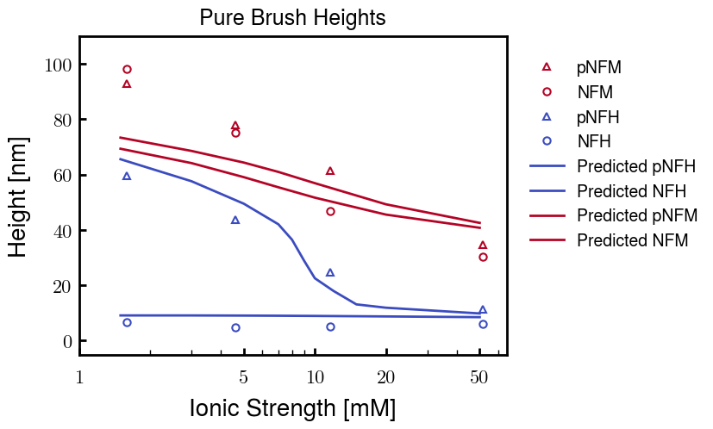
Although the height for pNFM is too short for low Cs, these curves are the best fit

Slide 3
Analysis of other pNFM fitting paramters
b: Kuhn’s monomer length
v: Kuhn’s monomer volume
Degree of coarse graining
Charge of phosphorylated sites
chi: Flory-Huggins parameter (based on amino acid)
Not shown below; made curves worse

Slide 4
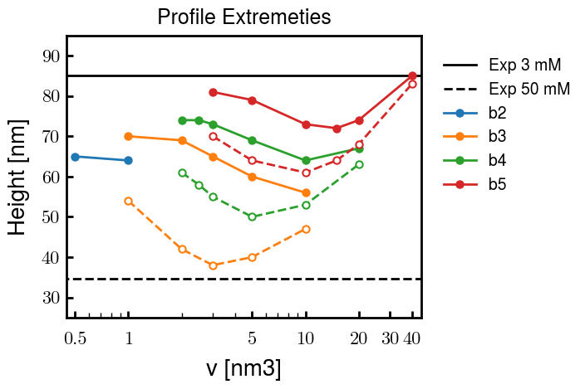
b and v values : Comparison of heights at 3 mM (solid lines) and 50 mM (dashed)
b = 2.0 nm
b = 3.0, v = 2.0 used for results on prev. slide

Slide 5
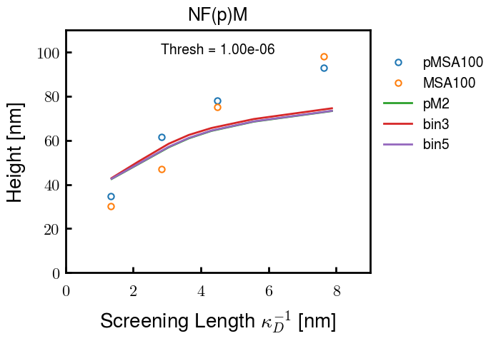
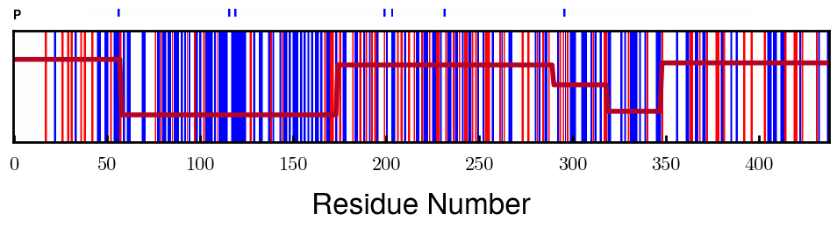
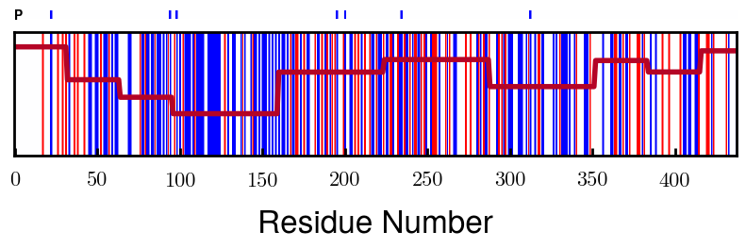
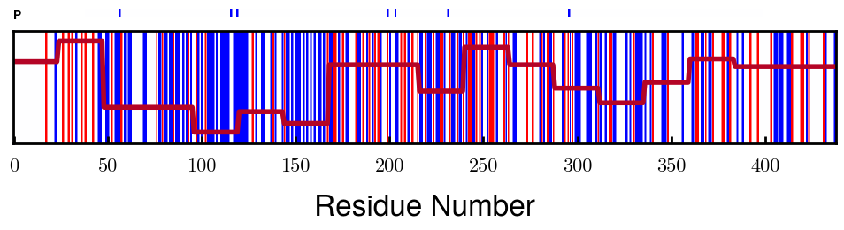
Finer coarse-graining makes little difference
Finer
Note: This is also a demonstration that the coarse-graining is pretty good and finding appropriate the most appropriate blocks

Slide 6
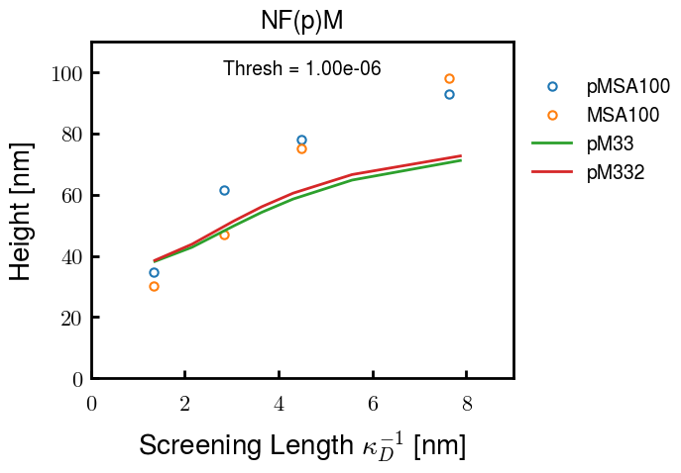
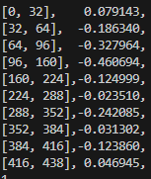
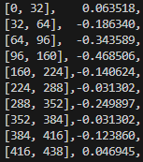
Degree of phosphorylation (-2.0e instead of -1.5e) also similarly little difference (not many units)
Affected blocks

Slide 7
Results
Notes:
b and v values between non- and phosphorylated NFH and NFM are the same; only difference is charge distribution
-1.5e used for charge of phosphorylated sites
Same chi values for each amino acid were used for all results

Slide 8
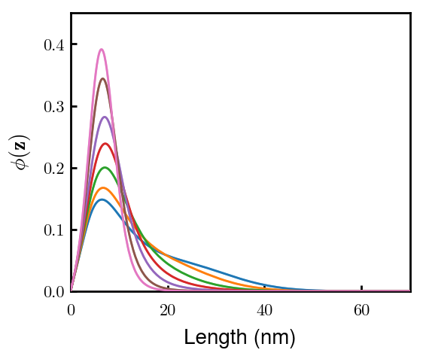
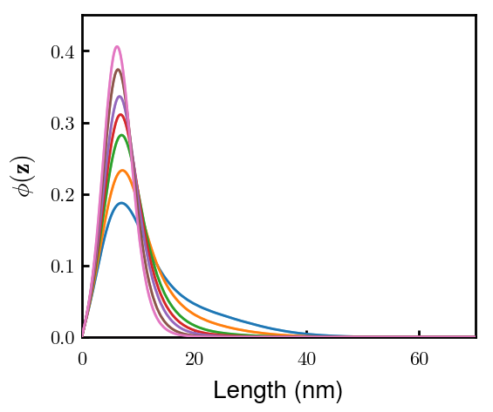
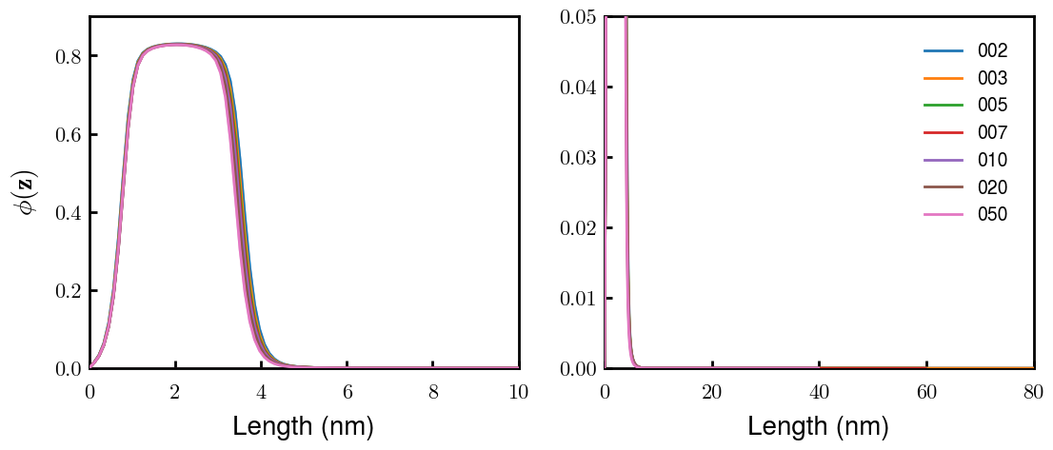
There are no significant differences between pNFM (left) and NFM (right).
mM ionic strength
Stronger shoulder
Very few phosphorylation sites on NFM, leading to little difference

Slide 9
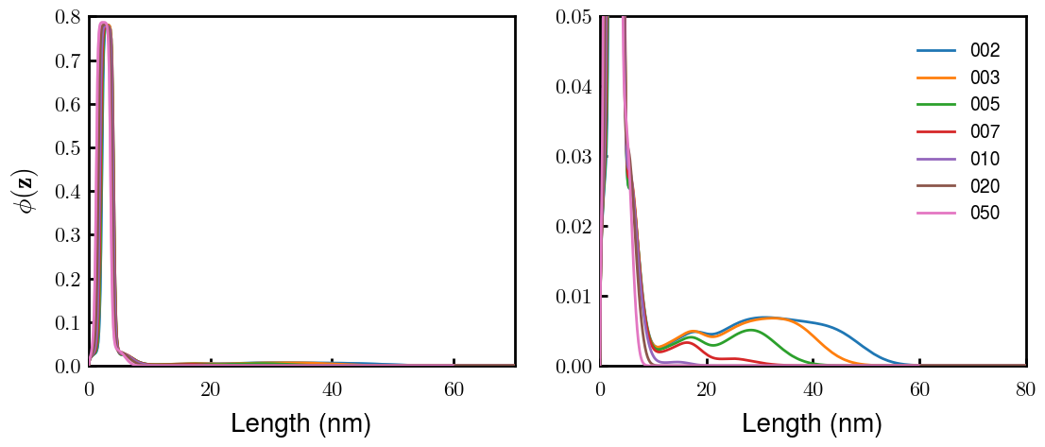
pNFH (left) and NFH (right) are extremely different
In contrast to NFM, NFH has very many phosphorylation sites.

Slide 10
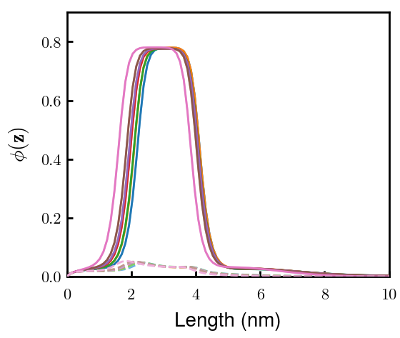
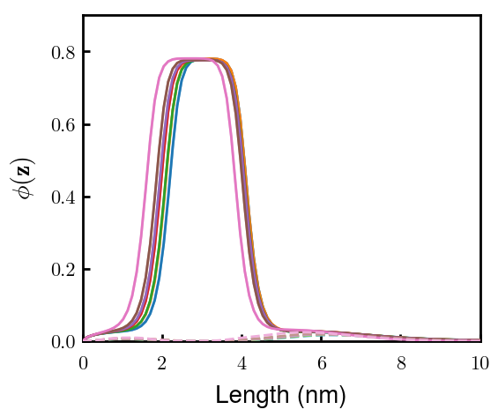
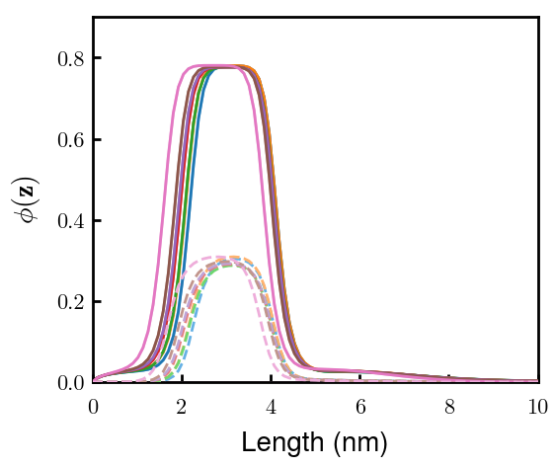
pNFH chains fold back after block 2 to form the inner condensed layer
Block 1
Block 2
Block 3
Remaining look like Block 3

Slide 11
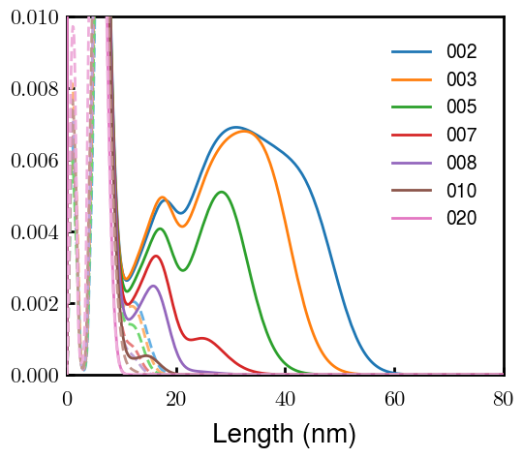
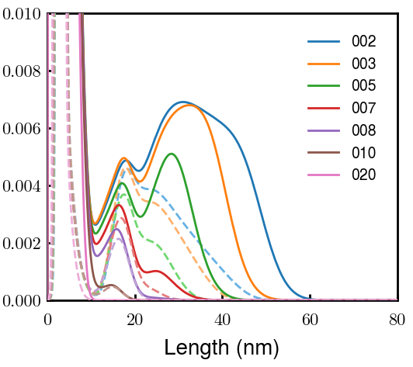
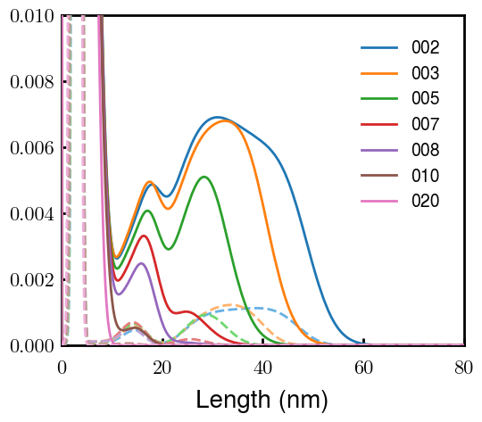
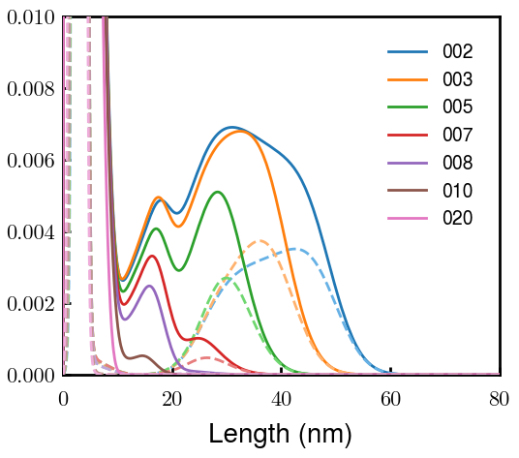
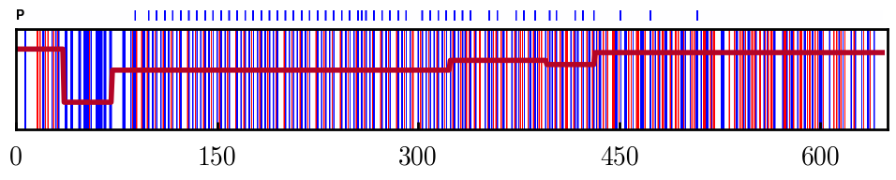
A fraction of pNFH chains do not fold back, forming the outer dilute layer
Block 2
Block 3
Block 4
Block 6
All dilute layers start with a distinct peak formed by Block 3. This is the region of KsP repeats

Slide 12
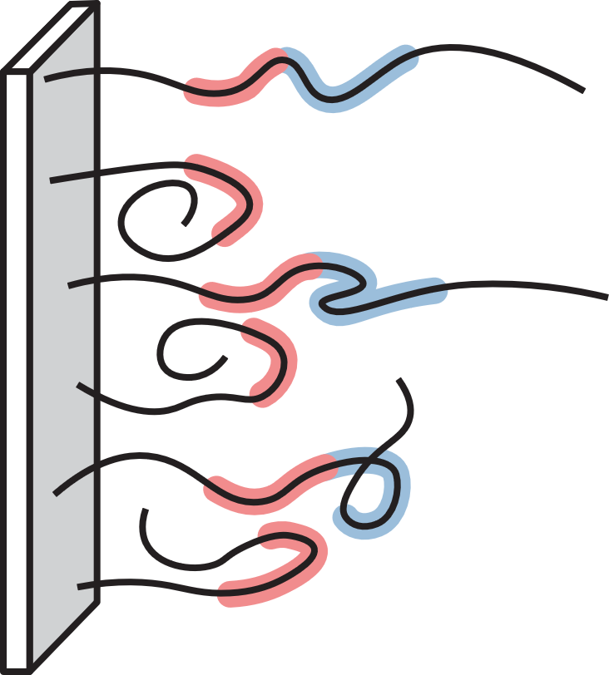
Thus, pNFH chains (at low ionic strengths) look something like this
Block 2
Block 3
2nd Block (red) either folds back or extends
3rd Block (blue) collects at interface between dilute and condensed layers
Crude schematic—I can try to make it look better later

